Slide 1


SAFE
STEP

Slide 2




Meet Our Team
Archisha R
Bharanidharan G
Swathi S
Trisha N
Archisha R

Slide 3

PROBLEM STATEMENT
Visually impaired individuals face challenges navigating their surroundings independently due to limited perception.
Traditional aids like canes have limitations, especially in complex environments.
There's a need for advanced technology to enhance their mobility and autonomy.

Slide 4
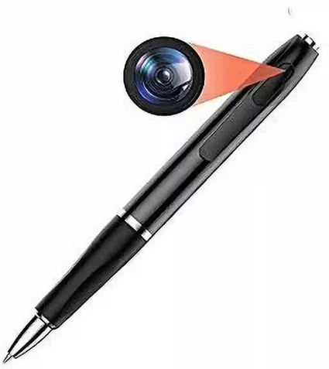
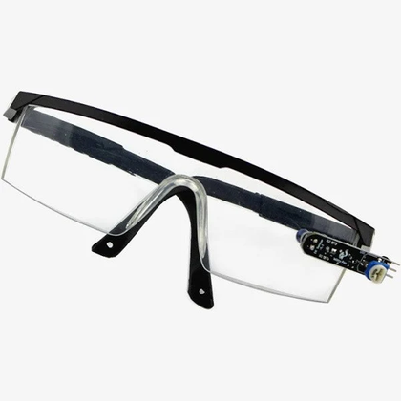
EXISTING SOLTUION
01
Alerting individuals to nearby objects is done with alarm sounds to warn of obstacles ahead.
02
A small pen with sensors detects objects ahead for pre-checking.
03
Blind individuals use white canes for tactile feedback on ground obstacles.

Slide 5
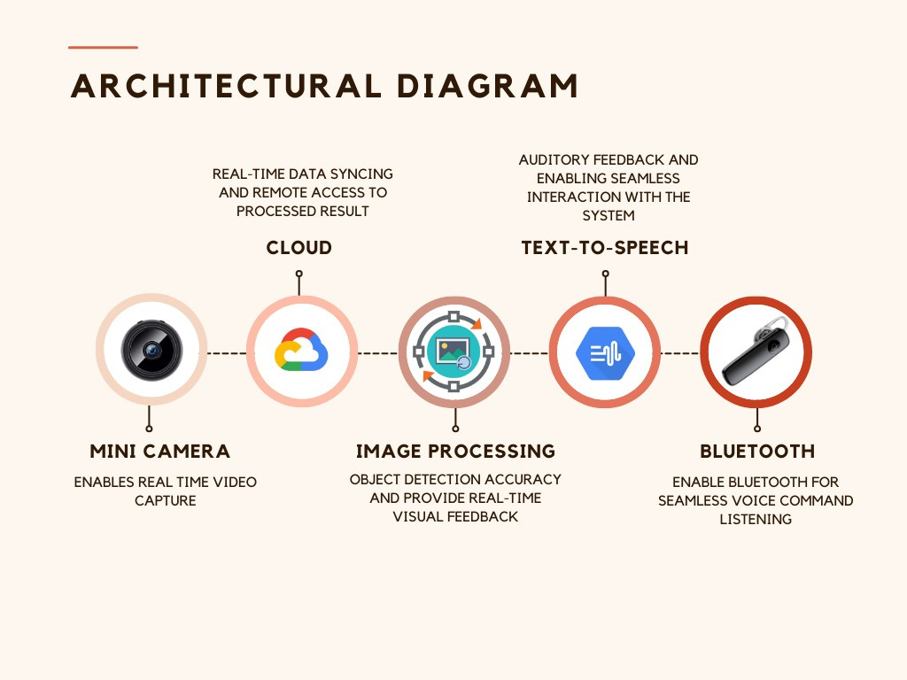

Slide 6







NOVELTY
The VISION MATE features an NFC (Near-Field Communication) chip enabling seamless Wi-Fi and Bluetooth connectivity by simply tapping your phone nearby, enhancing connection speeds within close proximity.
01
Embedded within the sunglasses is a camera that captures images of the surrounding environment, utilizing machine learning algorithms to identify objects (even at night) within the pictures.
02
Following image processing, the results are converted into text and subsequently translated into voice, providing users with audible directions and guidance.
03

Slide 7















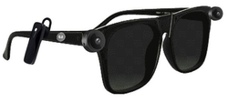
PROGRAMMING LANGUAGE
FRAMEWORK AND LIBRARY
CLOUD SERVICES
DEVELOPING TOOLS
DESIGN TOOLS
TECH STACK
HARDWARE COMPONENTS
API’S AND INTEGRATION
DATABASE

Slide 8

BUSINESS MODEL CANVAS
CUSTOMER SEGMENTS
KEY PARTNERS
KEY ACTIVITIES
VALUE PROPOSITIONS
VISUALLY IMPAIRED INDIVIDUALS
CAREGIVERS AND SUPPORT NETWORKS
CUSTOMER RELATIONSHIP
HARDWARE SUPPLIERS
SOFTWARE DEVELOPERS
ACCESSIBILITY ORGANIZATIONS
PROTOTYPING
USER TESTING
MANUFACTURING
ENHANCED MOBILITY
REAL-TIME ASSISTANCE
USER-CENTRIC DESIGN
IMPROVED QUALITY OF LIFE
PERSONALIZED ASSISTANCE
ACCESSIBILITY SUPPORT
CONTINUOUS IMPROVEMENT
TECHNOLOGY EXPERTISE
FUNDING
INTELLECTUAL PROPERTY
DIRECT SALES
PARTNERSHIPS
ONLINE PRESENCE
KEY RESOURCES
CHANNEL
COST STRUCTURE
REVENUE STREAM
MANUFACTURING COSTS
MARKETING AND PROMOTION
OPERATIONAL COSTS
PRODUCT SALES
SUBSCRIPTION OR SERVICE MODEL
LICENSING OR PARTNERSHIPS

Slide 9
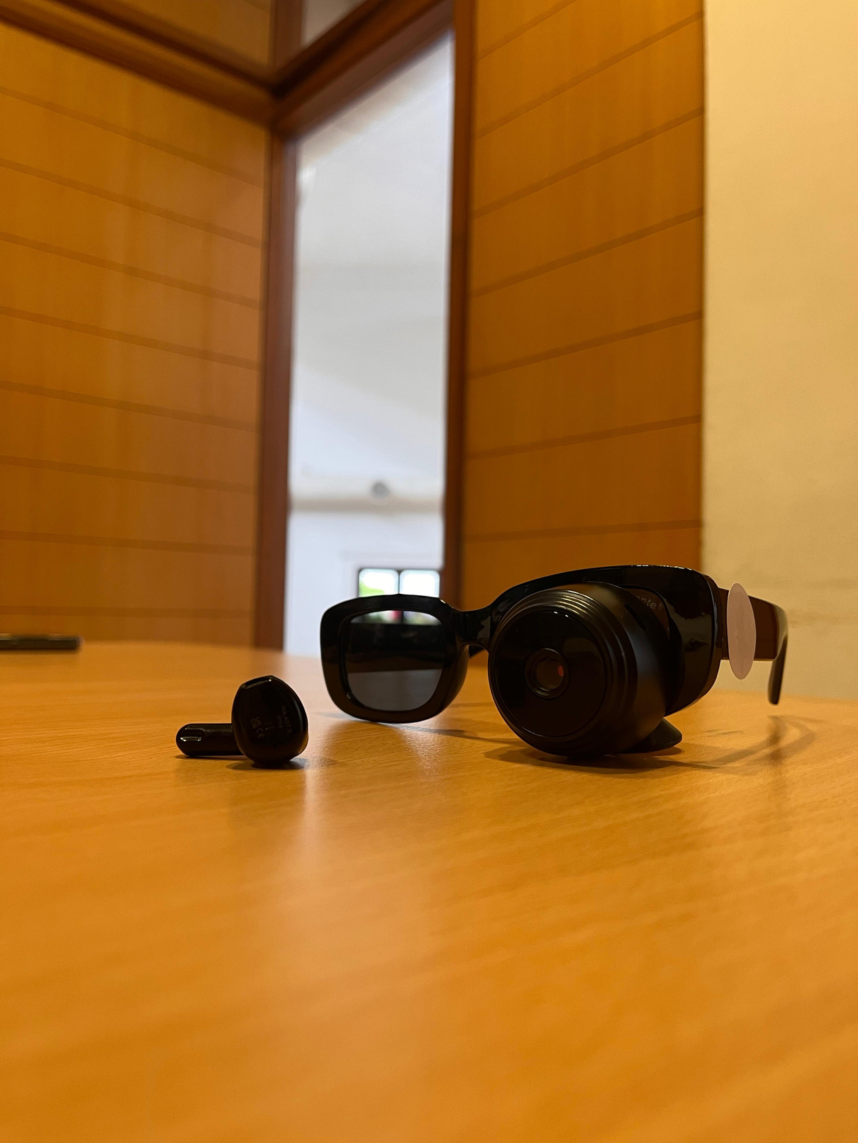
PROTOTYPE

Slide 10

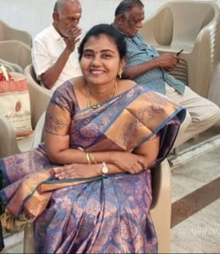
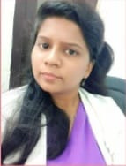
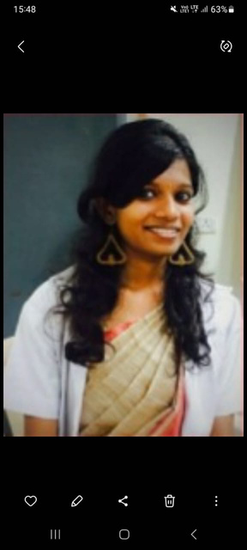

FEEDBACK
DR.KAVITHA
DR.NISHCITHA
OPHTHALMOLOGIST
DR.HARSHITHA
I believe the concept of using VISION MATE with NFC technology to aid navigation for visually impaired individuals is ingenious , This could revolutionize the way they interact with their environment and improve their overall quality of life
I applaud the creators for their innovative solution to aid the visually impaired. These glasses offer invaluable support and independence to those in need.
The proposed sunglasses with integrated camera and NFC tags offer a promising solution for individuals with visual impairments. Providing real-time feedback on their surroundings can greatly enhance their spatial awareness and safety.

Slide 11


THANK YOU

